Slide 1
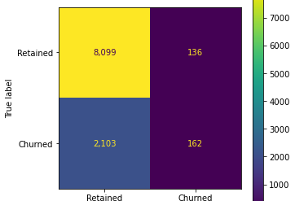
User Churn Prediction | Regression Model
Executive Summary
Prepared for: Waze Leadership Team
Waze Leadership has asked the data team to construct a predictive model of user churn rates. This is part of a bigger plan to increase user retention and the overall growth of the company.
Data team have decided to conduct a logistic regression to analyze and predict user churn (0-1 variable) against other factors that are provided in the dataset.
Model assumptions were analyzed, and fixed were made to handle outliers:
Linearity - Independent observations
Multicollinearity - No extreme outliers
Dataset was split into training and testing parts for model evaluation.
The model was trained and validated with respect to several metric: Accuracy, Precision, Recall, etc.
Current dataset leads to a poor Recall criterion (7.5%), i.e. the model can only detect 7.5% of actual churns.
The model’s Precision is 54%, i.e. among all reported churns, 54% are actual churns.
Confusion matrix describes the model’ performance:
`activity_days` has the highest contribution to decreasing of the churn, i.e. highest absolute coefficient.
Although `km_per_driving_day` has the highest correlation to the churn, it has almost no effect in the model, which means it may interact with other factors in the overall influence.
Due to the model results, our team recommends using the key insights from this project milestone to guide further exploration.
This model should not be used to make significant business decisions; however, it has valuable insights insofar as it demonstrated a great need for additional data (features) that correlates with user churn, and also a possible need to better define the user profile Waze seeks to target in their aim to increase overall growth by preventing monthly user churn on the app.

Slide 2
Title
Subtitle
Project Overview
Image Alt-Text Here

Slide 3
Title
Subtitle
Image Alt-Text Here
Image Alt-Text Here

Slide 4
Title
Subtitle
Image Alt-Text Here

Slide 5
Title
Subtitle

Slide 6
Title
Subtitle
Image Alt-Text Here

Slide 7
Title
Subtitle

